Slide 1
Functions
⠀⠀⠀⠀⠀⠀⠀⠀⠀⠀⠀⠀⠀⠀⠀⠀⠀⠀⠀⠀⠀⠀⠀⠀⠀⠀⠀⢀⣀⣠⣤⣤⣤⣤⣤⣄⣀⠀⠀⠀⠀⠀⠀⠀⠀⠀⠀⠀⠀⠀⠀⠀⠀⠀⠀⠀⠀⠀⠀⠀⠀⠀⠀⠀⠀ ⠀⠀⢀⣴⣶⣦⡀⠀⠀⠀⠀⠀⠀⠀⠀⠀⠀⠀⠀⠀⠀⠀⠀⣀⡴⠶⠛⠉⠁⠀⠀⠀⠀⠀⠀⠀⠀⠉⠓⠶⢄⡀⠀⠀⠀⠀⠀⠀⠀⠀⠀⠀⠀⠀⠀⠀⠀⠀⠀⠀⠀⠀⠀⠀⠀ ⠀⣴⠏⠀⢸⣿⠻⡄⠀⠀⠀⠀⠀⠀⠀⠀⠀⠀⠀⠀⣠⡴⠛⠉⠀⠀⠀⠀⠀⠀⠀⠀⠀⠀⠀⠀⠀⠀⠀⠀⠀⠉⠳⢦⡀⠀⠀⠀⠀⠀⠀⠀⠀⠀⠀⠀⠀⠀⠀⠀⠀⠀⠀⠀⠀ ⣸⠁⠀⠀⢸⣿⠀⢱⡀⠀⠀⠀⠀⠀⠀⠀⠀⠀⣠⡾⠋⠀⠀⠀⢀⣀⠀⠀⠀⠀⠀⠀⠀⠀⠀⠀⠀⠀⠀⠀⠀⠀⠀⠀⠙⢦⡀⠀⠀⠀⠀⠀⠀⠀⠀⠀⠀⠀⠀⠀⠀⠀⠀⠀⠀ ⣇⢀⠀⠀⢸⠟⠃⠀⢧⡀⠀⠀⠀⠀⠀⠀⢀⣼⠏⠀⠀⣠⣤⣶⣿⣟⢳⣶⣶⣤⣄⣀⡀⠀⠀⠀⠀⠀⠀⠀⠀⠀⠀⠀⠀⠀⠙⣦⠀⠀⠀⠀⠀⠀⠀⠀⠀⠀⠀⠀⠀⠀⠀⠀⠀ ⠘⠿⣶⣴⣤⣀⡀⠀⠀⠱⣄⠀⠀⠀⠀⢠⡿⢋⡇⢀⣾⡿⠿⠛⠋⠉⠉⠉⠛⠻⠿⢿⡿⠗⠀⠀⠀⠀⠀⠀⠀⠀⠀⠀⠀⠀⠀⠈⢧⡀⠀⠀⠀⠀⠀⠀⠀⠀⠀⠀⠀⠀⠀⠀⠀ ⠀⠀⠀⠀⠉⠙⠻⢦⣄⠀⠈⠳⢦⣀⣰⠟⢁⣨⡵⠏⠉⠀⠀⠀⠀⠀⠀⠀⠀⠀⠀⠀⠀⠀⠀⠀⠀⠀⠀⠀⠀⣴⣶⣶⠶⣦⣤⣀⣨⡷⣄⠀⠀⠀⠀⠀⠀⠀⠀⠀⠀⠀⡀⠐⠲ ⠀⠀⠀⠀⠀⠀⠀⠀⠙⢳⣄⠀⠀⢤⣥⡼⠛⠛⠇⠀⠀⠀⠀⠀⣀⣀⣉⣛⡳⢤⡀⠀⠀⠀⠀⠀⠀⠀⠀⠀⠀⠀⠀⠉⠙⠛⠷⠿⢿⣇⣽⣦⠀⠀⠀⠀⠀⠀⠀⠀⣠⡞⠁⠀⠀ ⠀⠀⠀⠀⠀⠀⠀⠀⠀⠐⠹⣦⣀⢚⠁⠂⠲⢦⣤⣀⣀⣤⣶⠿⢻⣭⣭⡛⠻⣦⡽⣦⠀⠀⠀⠀⠀⠀⠀⠀⠀⠀⠀⣀⣀⣀⠀⠀⠀⠉⠙⢿⣧⠀⠀⠀⠀⠀⣠⡼⠋⠀⠀⠀⠀ ⠀⠀⠀⠀⠀⠀⠀⠀⠀⠀⢀⣿⡏⠈⠀⠀⠀⠀⠀⠉⠛⠿⣽⣶⣿⠿⣿⣿⣀⣈⣷⡸⣆⡤⠤⠂⠀⠀⠠⠀⡀⠀⣺⣭⣥⡴⣦⣤⣅⠀⠀⠀⢸⡀⠀⣠⡴⠚⠉⠀⠀⠲⣄⠀⠀ ⠀⠀⠀⠀⠀⠀⠀⠀⠀⠀⣾⣿⠄⠀⠀⠀⠀⠀⠀⠀⠀⠀⠀⠉⠙⠛⠛⠋⠊⠉⠁⠈⢁⡀⠀⠀⠀⠀⠀⠀⠳⣼⣏⣿⣿⣿⣦⠈⠙⢷⡀⠀⠀⠉⠉⠀⠀⢀⣀⣤⠴⠶⠿⠿⠦ ⠀⠀⠀⠀⠀⠀⠀⠀⠀⣸⡿⠃⠀⠀⠀⠀⠀⠀⠀⠀⠀⠀⠀⠀⠀⠀⠀⢀⡤⠀⠀⠀⠀⠀⠀⠀⠀⠀⠀⠀⠀⠀⠙⠻⠿⢿⣛⠒⠒⢛⠃⠀⠀⠀⢀⡤⠞⠋⠀⠀⠀⠀⠀⠀⠀ ⠀⠀⠀⠀⠀⠀⠀⠀⢰⡿⢁⠀⠀⠀⠀⠀⠀⠀⠀⣀⣀⣀⠀⠀⠀⠀⣴⣏⠀⠀⣀⡖⠀⠀⠀⠀⠀⠀⠀⠀⠀⠀⠀⠀⠀⠀⠈⠉⠉⠁⠀⠀⠀⢰⣏⠀⠀⠀⠀⠀⠀⠀⠀⠀⠀ ⠀⠀⠀⠀⠀⠀⠀⠀⣾⡇⢸⠀⠀⠀⠀⠀⠀⣰⣾⡿⠿⠿⠛⠓⠀⠀⢿⣿⣿⣿⣿⣿⣶⣤⣀⠀⠀⠀⠀⠀⠀⠀⠀⠀⠀⠀⠀⠀⠀⠀⠀⠀⠀⠈⠋⣆⠀⠀⠀⠀⠀⠀⠀⠀⠀ ⠀⠀⠀⠀⠀⠀⠀⢠⣿⢡⠘⠀⠀⠀⠀⠀⢚⡏⠁⠀⠀⠀⠀⠀⠀⠀⠀⠈⠁⠙⠻⢿⣿⣯⡛⠻⢶⣶⣶⣶⣶⣶⣿⣷⣶⣶⣁⠀⠀⠀⠀⠀⠀⠀⠀⠙⡆⠀⠀⠀⠀⠀⠀⠀⠀ ⠀⠀⠀⠀⠀⠀⠀⢸⣿⣸⡁⠀⠀⠀⠀⠀⣾⠁⢙⢶⣄⡀⠀⠀⠀⠀⠀⠀⠀⠀⠀⠀⠀⠉⠉⠛⠓⠒⠒⠛⠉⠉⠉⠉⠉⠁⠈⠙⠶⣾⣷⣆⠀⠀⠀⠀⢹⠀⠀⠀⠀⠀⠀⠀⠀ ⠀⠀⠀⠀⠀⠀⠀⣾⣧⣿⠃⠀⠀⠀⠀⢸⡇⠀⠈⠁⠈⠙⠳⢦⣄⡀⠀⠀⠀⠀⠀⠀⠀⠀⠀⠀⠀⠀⠀⠀⠀⠀⠀⠀⠀⠀⠀⠀⠀⠀⠙⢿⣷⠀⠀⠀⢸⠀⠀⠀⠀⠀⠀⠀⠀ ⠀⠀⠀⠀⠀⠀⢠⣿⡿⠸⠀⠀⠀⠀⠀⢸⡇⠀⠀⠀⠀⠀⠀⠀⠀⠉⠛⠲⠦⢤⣤⣄⣀⡀⠀⠀⠀⠀⠀⠀⠀⠀⠀⠀⠀⠀⠀⠀⠀⣀⡤⠈⢿⡇⠀⠀⢸⠀⠀⠀⠀⠀⠀⠀⠀ ⠀⠀⠀⣀⣴⡾⢻⣿⠁⠀⠀⠀⠀⠀⠀⠘⣿⠀⠀⠀⠀⠀⠀⠀⠀⠀⠀⠀⠀⠀⠀⠉⠉⠙⠛⠒⠒⠲⠶⠶⠶⠶⠦⢤⣤⠤⠴⠒⠋⠉⠀⠀⠈⠃⠀⠀⡞⠀⠀⠀⠀⠀⠀⠀⠀ ⣴⣾⠿⣋⣭⣴⣿⠃⠀⠀⠀⠀⠀⠀⠀⠀⢻⡆⠀⠀⠀⠀⠀⠀⠀⠀⠀⠀⠀⠀⠀⠀⠀⠀⠀⠀⠀⠀⠀⠀⠀⠀⠀⠀⠀⠀⠀⠀⠀⠀⠀⠀⠀⠀⠀⢰⡇⠀⠀⠀⠀⠀⠀⠀⠀ ⣫⠾⣋⣽⣿⣷⣿⠀⠀⠀⠙⢧⡀⠀⠀⠀⠀⠷⠀⠀⠀⠀⠀⠀⠀⠀⠀⠀⠀⠀⠀⠀⠀⠀⠀⠀⠀⠀⠀⠀⠀⠀⠀⠀⠀⠀⠀⠀⠀⠀⠀⠀⠀⠀⠀⢸⣿⣆⠀⠀⠀⠀⠀⠀⠀ ⠋⣼⣿⢿⣶⣿⡇⠀⠀⠀⢀⠈⢿⣄⠀⠀⠀⠀⠀⠀⠀⠀⠀⠀⠀⠀⠀⠀⠀⠀⠀⠀⠀⠀⠀⠀⠀⠀⠀⠀⠀⠀⠀⠀⠀⠀⠀⠀⠀⠀⠀⠀⠀⠀⠀⢸⣿⡮⡛⣦⣄⠀⠀⠀⠀ ⣤⣿⣿⣾⣿⣿⡆⠀⠀⠀⠙⠄⠈⠻⣷⡀⠀⠀⠀⠀⠀⠀⠀⠀⠀⠀⠀⠀⠀⠀⠀⠀⠀⠀⠀⠀⠀⠀⠀⠀⠀⠀⠀⠀⠀⠀⠀⠀⠀⠀⠀⠀⠀⠀⠀⣼⢻⣷⢹⡎⣿⣷⣤⣀⣀ ⣿⣿⡿⣿⣿⠤⣫⡀⠀⠀⠀⠀⠀⠀⠈⢷⣄⠀⠀⠀⠀⠀⠀⠀⠀⠀⠀⠀⠀⠀⠀⠀⠀⠀⠀⠀⠀⠀⠀⠀⠀⠀⠀⠀⠀⠀⠀⠀⠀⠀⠀⠀⠀⠀⣼⢹⣬⣿⡞⢻⡿⣿⣧⡻⢿ ⣿⣿⣾⣿⡯⣠⣿⡇⠀⠀⠀⠀⠀⠀⠀⠀⠙⣷⡄⠀⠀⠀⠀⠀⠀⠀⠀⠀⠀⠀⠀⠀⠀⠀⠀⠀⠀⠀⠀⠀⠀⠀⠀⠀⠀⠀⠀⠀⠀⠀⠀⠀⠀⣼⠃⢸⣿⣿⠦⡄⢹⣾⣿⣷⠙ ⣿⣿⣿⣿⡿⠋⣿⣧⠀⠀⠀⠀⠀⠀⠀⠀⠀⠀⠉⠀⠀⠀⠀⠀⠀⠀⠀⠀⠀⠀⠀⠀⠀⠀⠀⠀⠀⠀⠀⠀⠀⠀⠀⠀⠀⠀⠀⠀⠀⢀⡴⢀⡼⠃⠀⢸⣿⡇⢠⣄⣘⣿⣷⡿⣷ ⣿⣿⣿⣿⡷⠘⣿⣿⠀⠀⠀⠀⠀⠀⠀⠀⠀⠀⠀⠀⠀⠀⠀⠀⠀⠀⠀⠀⠀⠀⠀⠀⠀⠀⠀⠀⠀⠀⠀⠀⠀⠀⠀⠀⠀⠀⠀⠀⡴⣋⣴⠟⠁⠀⣠⡿⣿⣇⣀⠉⣿⣿⡋⠱⣏ ⣿⣿⣿⣿⣧⠸⢻⣿⡆⠀⠀⠀⠀⠀⠀⠀⠀⠀⠀⠀⠀⠀⠀⠀⠀⠀⠀⠀⠀⠀⠀⠀⠀⠀⠀⠀⠀⠀⠀⠀⠀⠀⠀⠀⠀⣠⡴⣾⣾⠟⠁⠀⠀⣼⡏⣷⣿⣛⢻⣶⣿⠿⠿⣆⣟ ⣿⣿⣿⣿⣿⡂⠀⣿⣧⠀⠀⠀⠀⠀⠀⠀⠀⠀⠀⠀⠀⠀⠀⠀⠀⠀⠀⠀⠀⠀⠀⠀⠀⠀⠀⠀⠀⠀⠀⠀⠀⠀⠀⣠⣾⣽⡾⠟⠁⠀⠀⠀⣴⡟⢷⣿⣏⠛⢿⣿⣦⣄⡀⠛⠛ ⣿⣿⣿⣿⣿⣧⠠⠈⢿⡆⠀⠀⠀⠀⠀⠀⠀⠀⠀⠀⠀⠀⠀⠀⠀⠀⠀⠀⠀⠀⠀⠀⠀⠀⠀⠀⠀⠀⠰⠶⠶⣶⣿⡿⠛⠉⠀⠀⠀⠀⢀⣾⣿⢻⣿⠿⣿⡷⣾⣿⣍⣿⡇⢀⣴ ⣿⣿⣿⣿⣿⣿⡆⠀⠸⣷⡀⠀⠀⠀⠀⠀⠀⠀⠀⠀⠀⠀⠀⠉⠋⠓⠀⠠⠄⢀⠀⠀⠀⠀⠀⠀⠀⠀⠀⠴⠟⠉⠀⠀⠀⠀⠀⠀⣀⣼⣿⠟⠁⣾⣿⣧⣼⣏⢿⣯⡀⣽⠃⣾⠁ ⣿⣿⣿⣿⣿⣿⣿⡄⠀⢹⣿⡄⠀⠀⠀⠀⠀⠀⠀⠀⠀⠀⠀⠀⠀⠀⠀⠀⠀⠀⠀⠀⠈⠈⠁⠐⠂⠀⠀⠀⠀⠀⠀⠀⠀⠀⢠⣤⣼⡿⠋⢀⣾⣇⠈⣿⣏⣻⡟⠉⣿⢋⣿⠛⣷
Hyland Python Academy @ UCS

Slide 2
What is a Function in Python?
A custom command that follows a defined set of instructions
Sort of like a mini-program within your program
Functions must have a name – this is how they are called
Functions can take input and produce output

Slide 3
📞 Calling Functions
What functions have you called?
moveDown()
input("Enter: ")
shelly.forward(50)
shelly = Turtle()
shelly.color("blue")
print("HI THERE")
What do each of these have in common?
( )
functionName
Name of the function
Parentheses ( )
Input for the function
thing

Slide 4
✍ Defining Functions
You can create your own custom commands for Python!
def sayHi(name):
❡>
def, name of the function, parentheses, input, colon, enter, indent ❡

Slide 5
✍ Defining Functions: Body
The indented body is a set of commands to run whenever the function is called
def sayHi(name):
print("Hi, " + name)
print("Good day!")
->
->

Slide 6
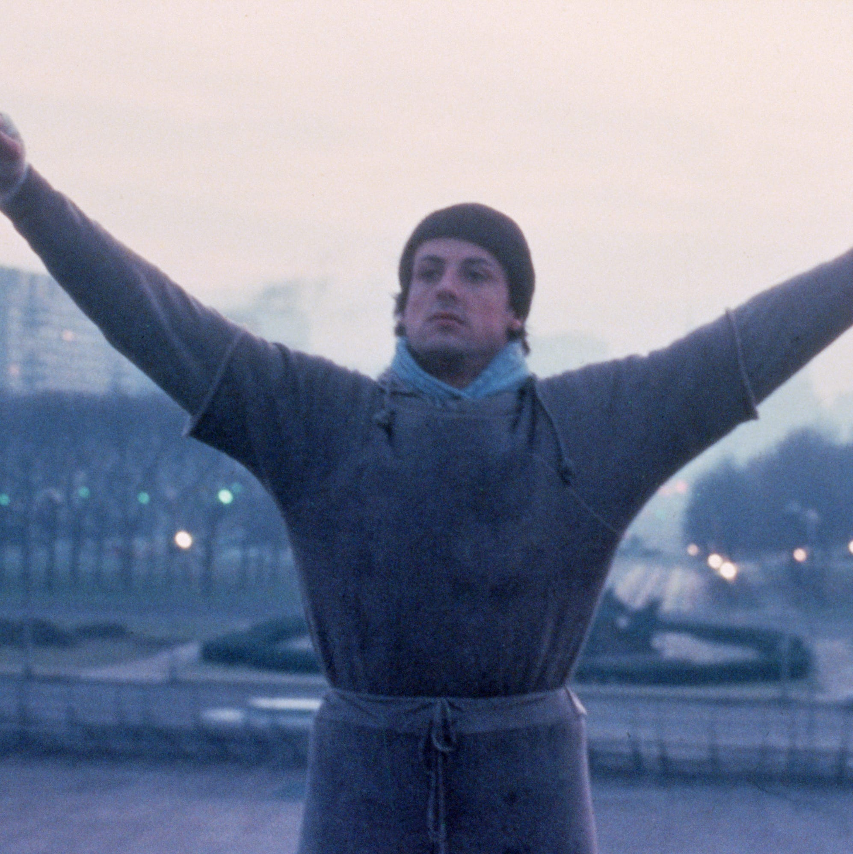
A Complete Example
Function Definition
def greet(person)
print("yo " + person)
greet("Adrian")
Function Call
yo Adrian
What will be printed?

Slide 7
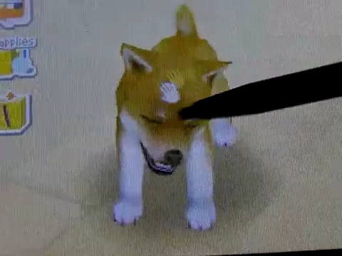
Analogy: Pet Tricks

Slide 8
Analogy: Pet Tricks
Defining a Function…
Calling a Function…
…is like teaching your dog how to do a trick
def breakdance():
play_dead()
turn_around()
…is like commanding your dog to do the trick
breakdance()

Slide 9
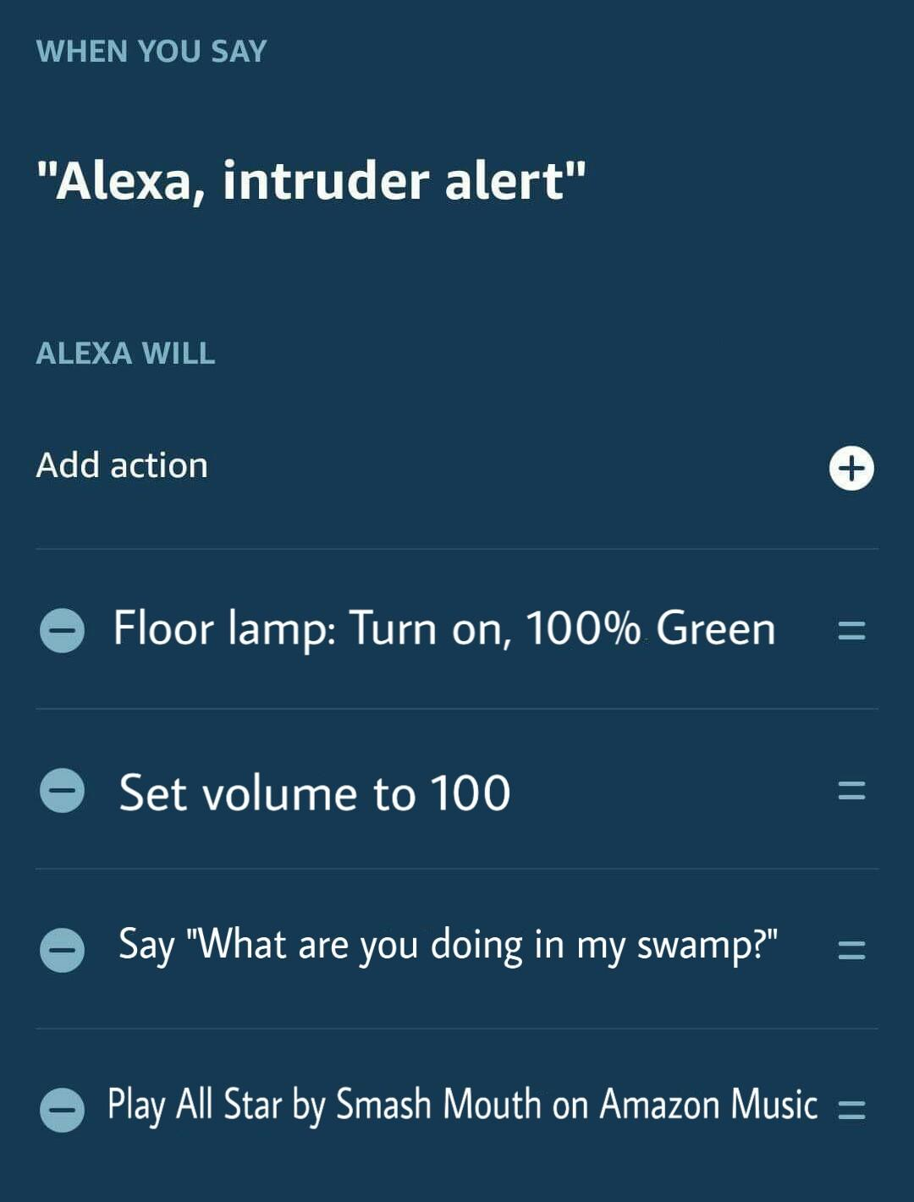
ALEXA CUSTOM ROUTINES
Defining a function is like building a custom routine for Alexa…
WHEN YOU SAY <function_name>
ALEXA WILL <function_body>
Calling a function is like invoking a custom routine for Alexa…
User says “<function_name>”
→ Execute <function_body>
Notes:
Let’s talk a little more about the difference between defining and calling methods.
In this example, an Alexa owner has created a custom command. Presumably, this would be used in the case of a home invasion. When the person says “Alexa, intruder alert,” the green lamp will turn on, the volume will be set to 100, Alexa will say the phrase, and All Star will play.
This is actually a lot like defining a method in C#!
The command phrase is like the method name, and the action list is like the method body.
Calling a method will run all of the actions defined in the custom command.

Slide 10
Aside: Multiple Python Files
def intruder_alert():
room.color("green")
speaker.volume(100)
print("GET OUT ME SWAMP")
print("🎵 someBODY once told me...")
shrek.py
from shrek import *
intruder_alert()
Turns the room green, sets the volume to 100, says the message, starts the song
main.py

Slide 11


Slide 12
Questions?
Hyland Python Academy @ UCS
Notes:
Anyone have any questions?

